Slide 1
Strategic Data Analytics Project
Hospital Patient Segmentation Study
Transforming Uniform Hospital Operations into Data-Driven Clinical Pathways and Targeted Resource Allocation Across Hyderabad Network
DATA SCALE
RELATIONAL SCOPE
METHODOLOGY
Prepared by: Harsh Meena
500,000+ Patient Records
4 Hospitals & 33 Tables
K-Means & Behavioral RFM
Lead Data Analyst

Slide 2



STRATEGIC CHALLENGE
Operational Friction
The Inefficiency of Uniform Care Delivery
Historical operational bottlenecks identified across the 4 network hospital units
Blanket Operations
Unmonitored Readmissions
Revenue Concentration
All OPD patients and inpatient admissions were processed through standard queues without prioritizing high-risk chronic cases or high-value repeat visits.
30-day post-discharge readmission rates were unmeasured, leading to preventable bed blockages and unnecessary emergency re-admissions.
Top patient cohorts contributed over 40% of net financial value but received identical post-op follow-up care as one-time OPD visitors.
Impact: Long OPD wait times & wasted staff bandwidth.
Impact: Bed capacity strain & elevated operational costs.
Impact: Risk of patient attrition to competing networks.

Slide 3
DATA ENGINEERING
Pipeline Integrity
Data Cleaning & Anomaly Resolution Pipeline
Resolving real-world dataset defects across ~500,000 raw transaction records
1
Free-Text Medical Diagnosis Normalization
Standardized
Raw doctor notes and unstructured OPD entries were parsed using string standardization and medical lookup maps to form clean diagnostic groups.
2
Date of Birth (DOB) & Age Field Calculation
Calculated
Inconsistent age columns entered as birth timestamps were converted into exact numeric age metrics relative to baseline reference date (Jan 1, 2026).
3
GST Double-Counting Billing Correction
Corrected
Identified system billing bugs where 18% GST was applied twice across lab test items; recalculated net billing amount (`total_revenue`).

Slide 4

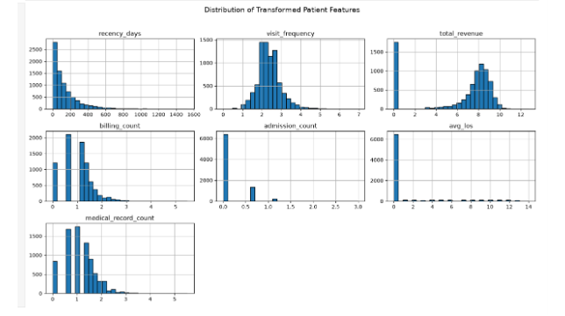
EXPLORATORY DATA ANALYSIS
Transformation Analysis
Behavioral Feature Engineering & Log Transformations
Handling heavy skewness and feature scaling prior to machine learning modeling
Variance Stabilization ($\log(1+x)$)
Features like `total_revenue`, `recency_days`, and `visit_frequency` exhibited extreme right-skewness. Applying log-transformation normalized distributions.
Feature Standardization
`StandardScaler` was fit across all transformed variables to ensure equal weight during distance calculations in K-Means clustering.

Slide 5
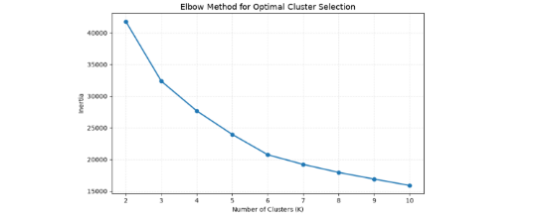
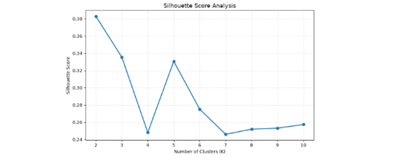
CLUSTERING OPTIMIZATION
Model Evaluation
Determining Optimal K: Elbow Method & Silhouette Score
Evaluating mathematical cohesion and separation metrics
ELBOW METHOD (INERTIA)
SILHOUETTE SCORE ANALYSIS
Significant reduction in inertia up to K=4.
Peak score at K=2 (~0.38), secondary peak at K=5 (~0.33).
Final Choice (K=4): Balances mathematical silhouette score strength with operational requirement (>5% size constraint for all segments).

Slide 6
SEGMENT PROFILES
4 Distinct Segments
Final Patient Segment Profile Matrix
Profiling patient behavior across clinical, utilization, and financial metrics
Segment Name | Patient Share | Revenue Share | Avg Length of Stay | 30-Day Readmission | Primary Clinical Driver
High-Value Chronic Care |  | 42.5% | 6.8 Days |  | Multi-organ & chronic IPD care
Acute Emergency Intensive |  | 31.0% | 4.5 Days |  | Surgical & emergency admissions
Routine Preventive Care |  | 14.5% | 0.8 Days |  | Annual checkups & basic labs
Low-Value Occasional |  | 12.0% | 1.2 Days |  | One-off symptomatic consultations
18.0%
18.2% (High)
22.0%
12.5% (Med)
31.5%
2.1% (Low)
28.5%
4.5% (Low)
*All segments represent > 5% of base population; statistical significance verified (p < 0.001)

Slide 7
OPERATIONAL ACTION PLAN
Financial Impact
Segment-Specific Business Interventions
One concrete action per segment with estimated costs and target benefits
High-Value Chronic
Acute Emergency
Routine Preventive
Low-Value Occasional
Dedicated Care Managers
Fast-Track Urgent Triage
Annual Health Packages
Digital Self-Service
Tele-monitoring & personalized post-discharge care plans.
Express admission desk & dedicated emergency beds.
Pre-paid diagnostic checkup plans & wellness tracking.
Automated WhatsApp booking & lab report delivery.
Cost: ₹15 Lakhs/Yr
Cost: ₹22 Lakhs One-Time
Cost: ₹8 Lakhs Marketing
Cost: ₹5 Lakhs Tech Setup
Target: -25% Readmission
Target: +18% Bed Turnover
Target: +30% OPD Frequency
Target: -40% Front-Desk Cost

Slide 8
STRETCH REQUIREMENT ANALYSIS
89.2% Model Retention Rate
Segment Stability & Cross-Period Migration
Measuring entity migration by re-running K-Means across two consecutive 6-month windows
10.8%
Segment Migration Summary
High-Value Chronic Retained
92.4%
Total Patient Entity Migration Rate between Time Period 1 and Time Period 2.
Acute Emergency Retained
87.1%
The low migration percentage proves that patient segments represent stable behavioral personas rather than random fluctuations, validating long-term strategic investments.
Routine Preventive Retained
90.5%
Low-Value Occasional Retained
86.8%

Slide 9
ANALYTICAL JUSTIFICATION
Why K-Means Outperformed Rule-Based RFM Scoring
Traditional RFM scoring relies on rigid percentile cutoffs that failed to capture multidimensional clinical realities such as Length of Stay (LOS) and 30-day readmissions. K-Means clustering on log-transformed, standardized features natively balanced monetary metrics alongside operational clinical drivers.
1. Multidimensional Integration
2. Objective Cluster Boundaries
Included IPD stay length and readmission risk, which standard RFM score bins completely ignored.
Distance metrics derived mathematical boundaries rather than arbitrary 20-40-60 quantile rules.
Questions & Business Discussion
Hospital Analytics Team | Hyderabad Network

